Slide 1
Agentic Healthcare Payment Integrity Review Assistant
Maithili Annavarapu
maithili.a7@gmail.com

Slide 2
Problem
Millions of healthcare claims are processed every year.
Manual claim review is slow and expensive.
Reviewers must evaluate:
Clinical appropriateness
Billing accuracy
Provider behavior
Potential fraud
Existing workflows require reviewing multiple sources of information before making a decision.
Goal: Develop an explainable AI assistant that helps payment integrity reviewers make faster and more consistent claim decisions.

Slide 3
Proposed Solution
Instead of using one large AI model,
I designed an agentic AI architecture where multiple specialist tools independently review different aspects of a healthcare claim. I have used Synthea dataset for this project.
Each tool contributes its expertise before a final decision agent combines the results into one explainable recommendation.
Benefits
Explainable
Modular
Easy to extend
Human-in-the-loop
Transparent decision making

Slide 4
Business Value
The proposed architecture can help organizations:
Reduce manual review effort
Detect suspicious billing patterns earlier
Improve reviewer productivity
Generate consistent claim explanations
Support payment integrity teams with evidence-based recommendations
Potential future applications:
Clinical document summarization
Real-time claim prioritization
Reviewer feedback learning

Slide 5
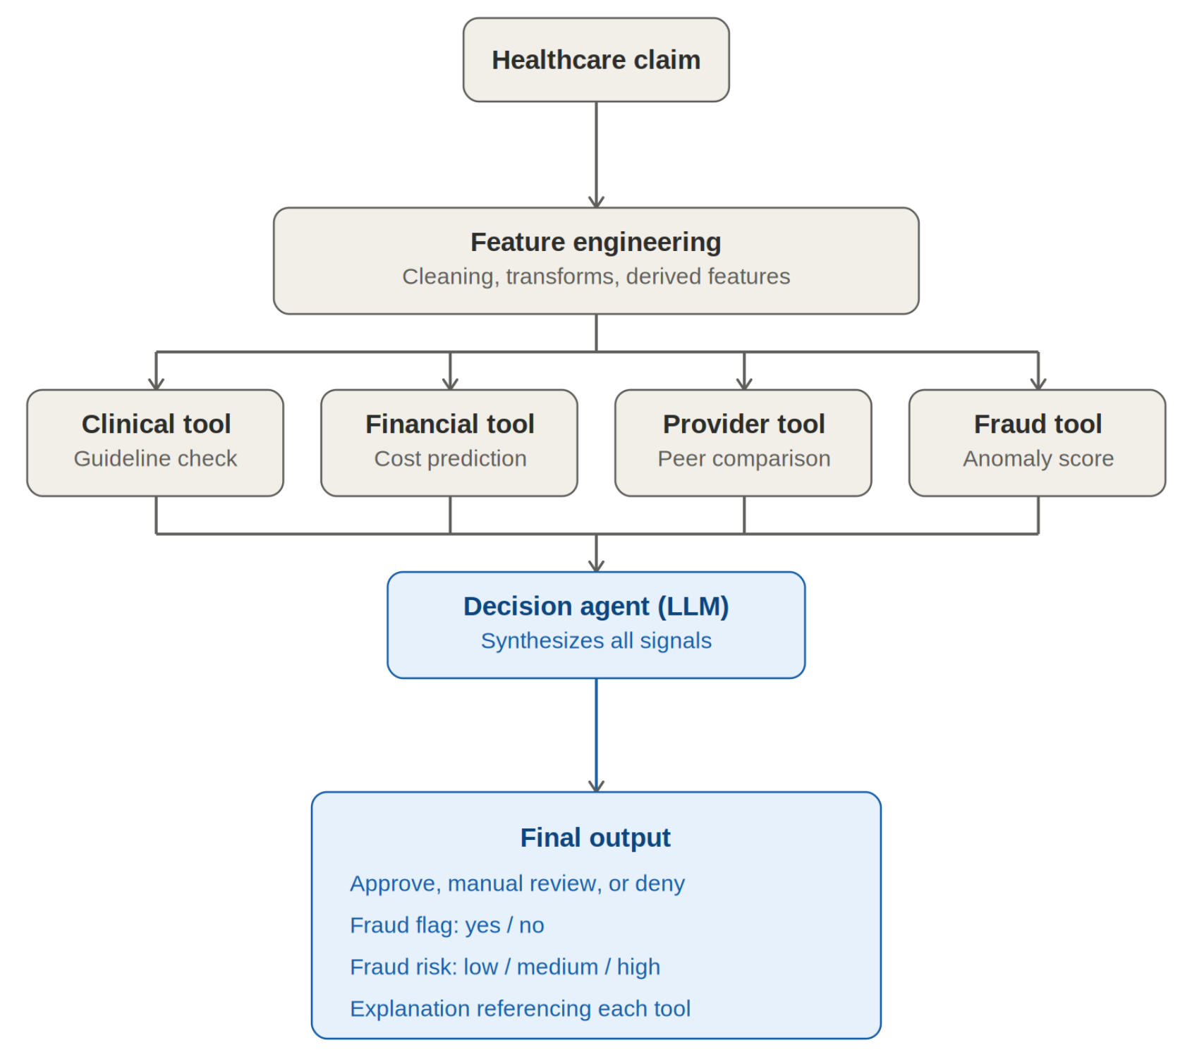
System Architecture

Slide 6
Specialist Tools
Clinical Tool
Lightweight RAG
Retrieves clinical guideline evidence
LLM evaluates clinical appropriateness
Financial Tool
Random Forest Regressor
Predicts expected claim amount
LLM explains financial deviation
Provider Tool
Provider utilization
Historical billing patterns
Specialty comparisons
Provider behavior assessment
Fraud Tool
Isolation Forest
Detects anomalous claims
Fraud score
Potential fraud indicator

Slide 7
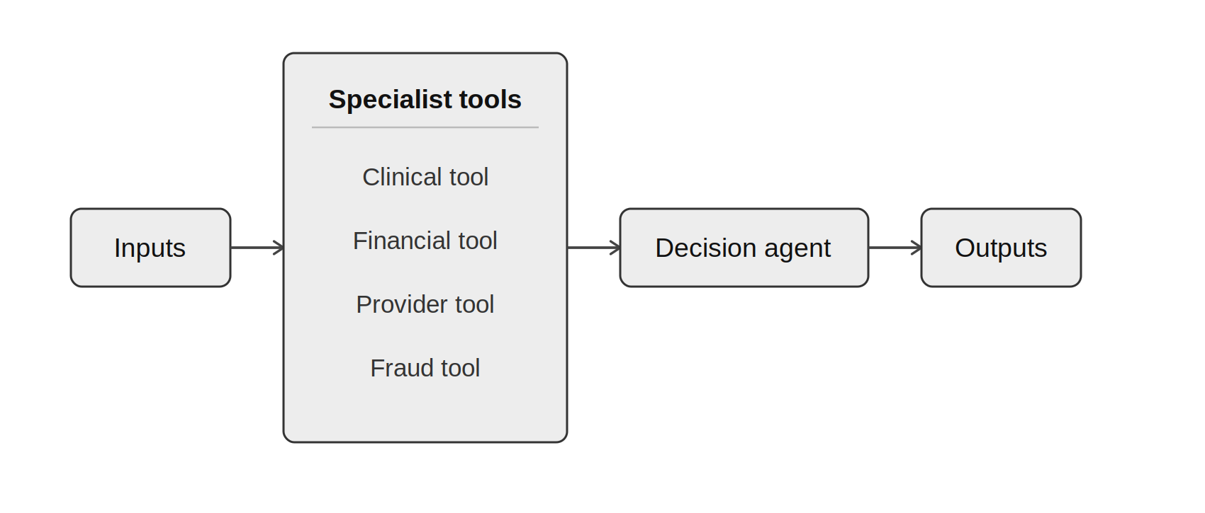
Decision Agent
Outputs
Approve
Manual Review
Deny
Fraud Risk
Risk Score
Explainable Recommendation

Slide 8
Evaluation
Created a synthetic test dataset with 20 representative healthcare claims.
Included scenarios such as normal claims, duplicate claims, repeat procedures, clinical mismatches, high-value claims, and fraud anomalies.
Results
Claim Decision Accuracy: 18/20 (90%)
Fraud Flag Accuracy: 18/20 (90%)
Average End-to-End Latency: ≈ 4 seconds
Successfully generated explainable recommendations for all test cases.

Slide 9
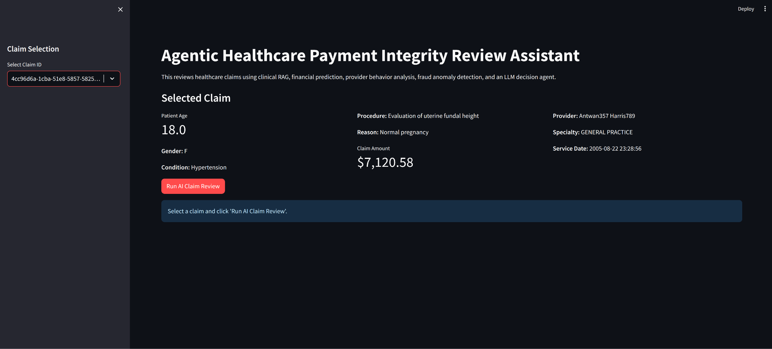
Demonstration

Slide 10
Conclusion
Developed an Agentic Healthcare Payment Integrity Review Assistant for healthcare claim review.
Combined RAG, Random Forest Regression, Provider Behavior Analysis, Isolation Forest, and LLM reasoning into a modular AI workflow.
Generated transparent and explainable claim review recommendations to support payment integrity analysts.
Demonstrated how Agentic AI can improve efficiency, consistency, and decision support while keeping humans involved in the review process.

Slide 11
Future Work
Larger clinical knowledge base
Real payer policies
Provider network analytics
Real-time claims processing
Learning from reviewer feedback
Deployment on cloud infrastructure
Integration with enterprise healthcare systems

Slide 12
THANK YOU

